Slide 1


AIBridge
Lecture 1

Slide 2

AIBridge
Bridge the gap between AI and [your choice]
1st camp at UC Davis in June 2022, 2nd in Silicon Valley in March 2023, 3rd at Cornell in July 2023
Acquire basics: Python, basic ML algorithms, toolbox usage
Enable further learning
Enable easier communications and collaborations
AIFS - NSF/USDA AI Institute for Next Generation Food Systems
Notes:
Mechanics analogy

Slide 3
AI in Food Systems
Molecular breeding
Help breeders to run more efficient and targeted breeding programs
Agricultural production
Crop yield sensing and forecasting
Water and nitrogen stress sensing, prediction, accusation
Food processing
Tomato processing loss prediction
Sanitation classification
Nutrition
Use food photo and text to predict core ingredients
Dietary recommendation

Slide 4
WHAT IS AI/ML?
AI vs. ML
Notes:
I understand that many of you are here because of the popularity of AI. So what is AI? To answer this seemingly simple question is actually fairly complicated. At its simplest form, artificial intelligence is a field, which combines computer science and robust datasets, to enable problem-solving. Some definitions also include ”mimic human cognitive functions”. Through AI, a computer system uses math and logic to simulate the reasoning that people use to learn from new information and make decisions.
In this bootcamp, although we called it AIBridge. Our focus really is Machine learning. Our focus really is Machine learning. ML is a subset of AI which allows a machine to automatically learn from past data without programming explicitly.
We will use AI/ML interchangeablely in this camp. Do note there is a subtle difference between the two.
Following this line of thought of learning from past data, let’s look at what it means more precisely.
An “intelligent” computer uses AI to think like a human and perform tasks on its own. Machine learning is how a computer system develops its intelligence.
https://azure.microsoft.com/en-us/overview/artificial-intelligence-ai-vs-machine-learning/#introduction

Slide 5

What can AI do
Notes:
Roughly speaking, what AI does is to take data as input, and provide info as output, which can be used for many different purposes/decisions.

Slide 6
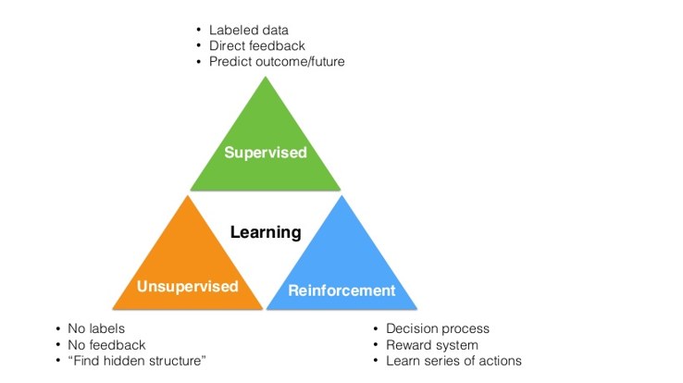
A High-Level View
Notes:
Unsupervised learning methods are used in bioinformatics for sequence analysis and genetic clustering; in data mining for sequence and pattern mining; in medical imaging for image segmentation; and in computer vision for object recognition.

Slide 7
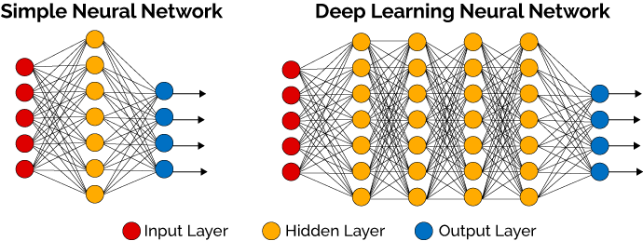
Deep Learning
Notes:
While we are not going to touch DL in this bootcamp, what we learn here are essential skills that you can use to explore DL.

Slide 8

Notes:
While we are not going to touch DL in this bootcamp, what we learn here are essential skills that you can use to explore DL.

Slide 9
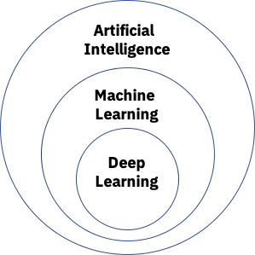
Our focus
Notes:
We largely focus on supervised learning and then a bit about unsupervised learning in terms of clustering and dimensionality reduction.

Slide 10
Terminology alignment
Sample = (features, label)
Features: independent variables, attributes, predictors, input variables, input, covariates, explanatory variables, treatment variables,
Label: dependent variable, outcome, target variable, outcome variable, response variable
Samples: cases, observations, individuals, participants, data points
If you have other names for these, please let me know.

Slide 11
Class Structure
Two blocks a day
A block : Lecture + break + lab
Lab is the best part of this bootcamp
Recap
Overview of key knowledge points
Feedback from you (pace, clarity, etc.)
Learning by doing
Iris dataset
Wine dataset
Go through the process to complete a basic ML project

Slide 12
Schedule
Python: 1.5 days
Condensed with a focus on what we need for ML
ML: 3.5 days
Intuitions, toolbox, ML flow
Friday afternoon: Project presentation
Notes:
How is it even possible to learn Python in 1.5 days?

Slide 13
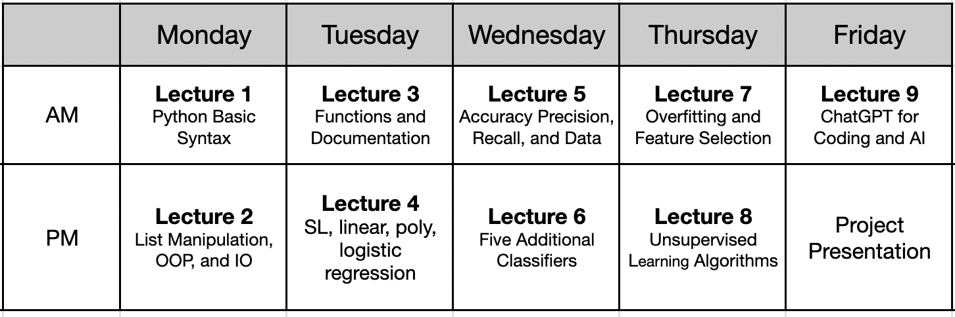
Schedule

Slide 14
Typical Practices in ML/Programming
Find a sample
Read through it
Try it
Modify it
Google it
Basic skills to do these and practice them
Notes:
In this bootcamp, we hope to equip you with basic skills to do these and also practice them in labs

Slide 15
Best Practices
Ask questions
Type along during lectures
Ask for help
Make good use of labs
Provide feedback
Notes:
How to make the best out of this bootcamp

Slide 16
Learning by Doing
Iris
Wine
Your own on Day 5 PM
Notes:
In Lab 1, we will look at these two datasets in more detail

Slide 17
Resources
Class notes, links in notes
Python: https://www.w3schools.com/python/
Sklearn user guide: https://scikit-learn.org/stable/user_guide.html
Google
ChatGPT*

Slide 18
INTRODUCTION TO PYTHON

Slide 19
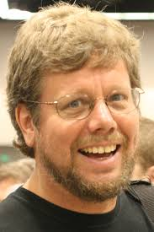
Python
Python is a popular programing language
Guido van Rossum, Dutch programmer, invented in late 1980s
Widely used in industry and academia, especially for ML applications.
R vs Python
Python better at large data amounts and machine learning
Notes:
When he began implementing Python, Guido van Rossum was also reading the published scripts from “Monty Python's Flying Circus”, a BBC comedy series from the 1970s. Van Rossum thought he needed a name that was short, unique, and slightly mysterious, so he decided to call the language Python.
Reminder to talk about how much python is used:
Web development, data analytics and machine learning, automation, scripting, etc. It is beginner friendly with simple syntax, versatile for many different tasks, open source, lot of modules and libraries.
Python and R are the preferred languages in Data Science, Data Analysis, Machine Learning, etc. Although they are used for similar purposes they differ from each other. R mainly focuses on the statistical part of a project while Python is flexible in its usage and data analysis tasks and has more ML libraries.
R is a powerful tool for visualizing data in the form of graphs. It is difficult to use R in a production environment due to its yet-to-develop production tools, whereas Python is easily integrated with a complex work environment.
Considering performance, Python is a better option as it runs faster in all the environments than R.
Python has an easier learning curve.

Slide 20
Lecture Outline
Google Colab
General Python Syntax
Variables
Logic
Control Flows

Slide 21
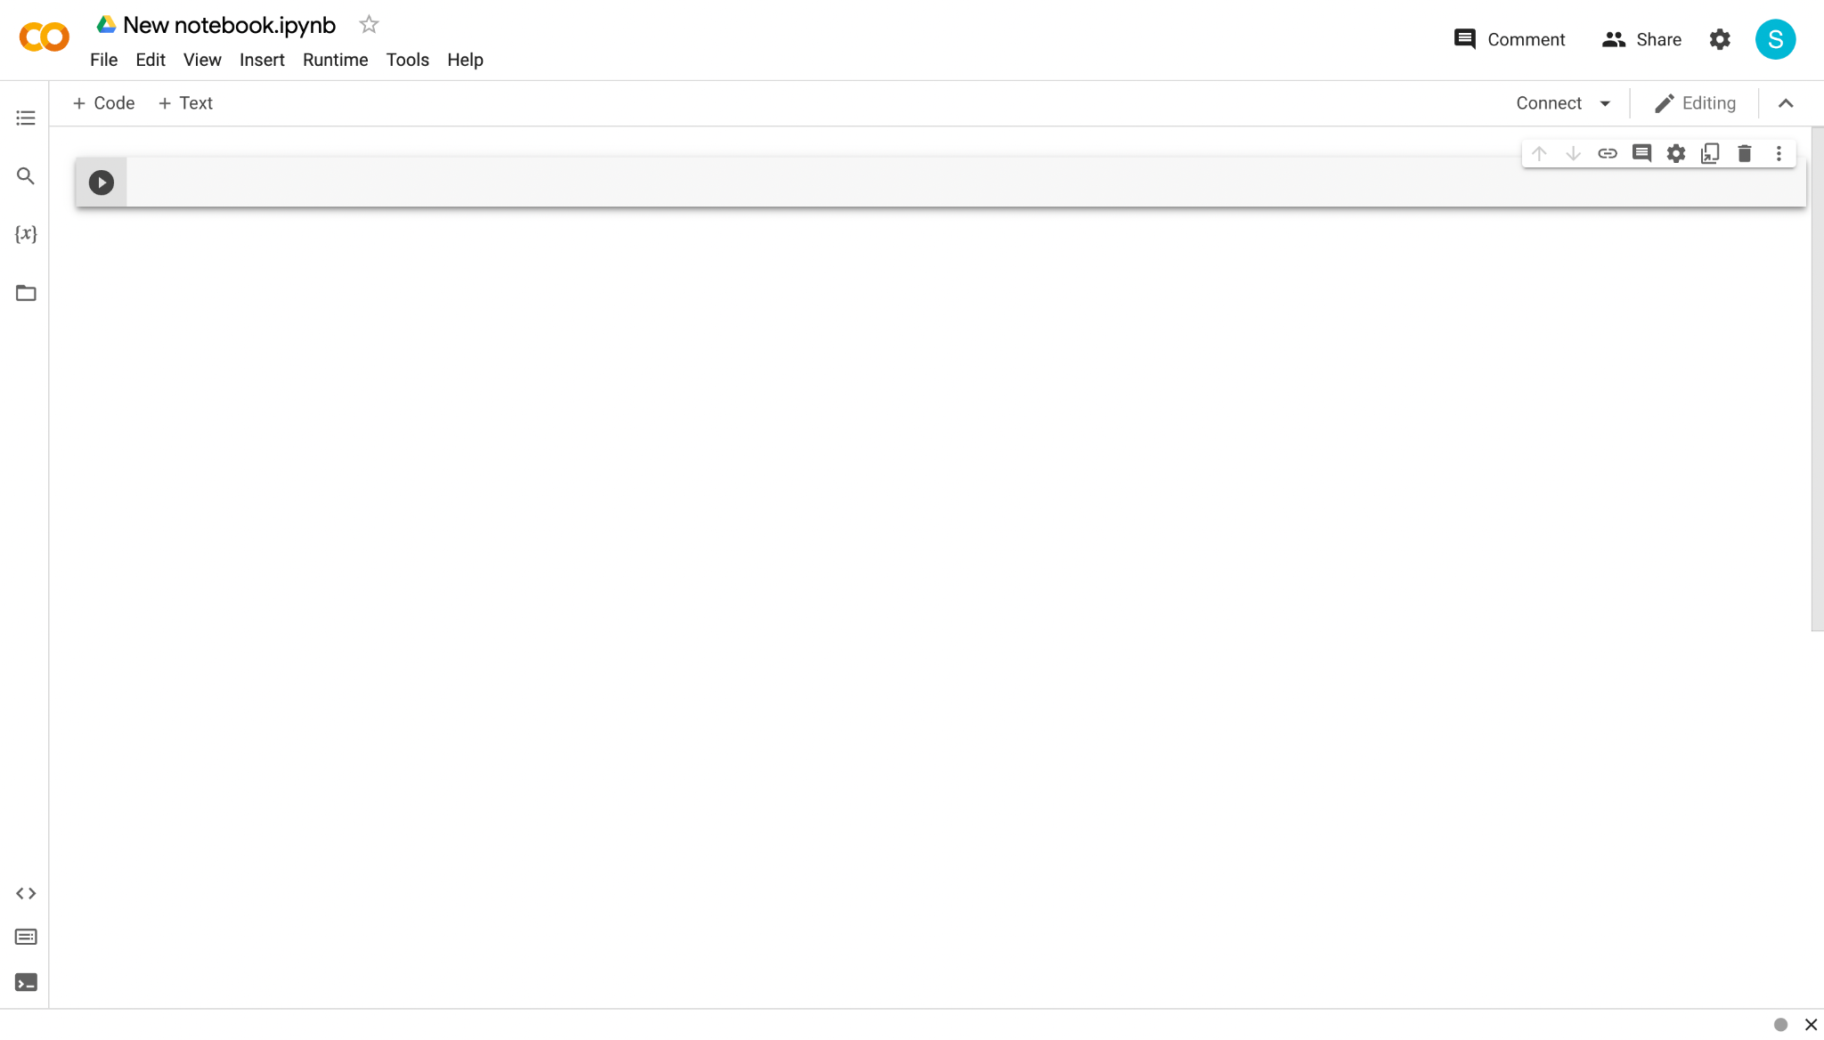
Google Colab
https://colab.research.google.com/
Stores everything on Google Drive
Can be shared with others and across devices
No setup required
Most packages/libraries preinstalled
Colab Pro
Follow along as we work through the Python language
Notes:
Our goal right now is very simple. We want to get you to ML as soon as possible. This is why we chose Google colab. Google Colab is kind of like Google Docs or Google Slides. Everything is stored on your own Google drive so you can always access it from any device and there’s no setup required. Could everyone open up Google Colab on a new browser window. The link is colab.research.google.com
Once you are on the website, select the option to make a new notebook

Slide 22

Google Colab
Delete cells by clicking this button
Add new cells by clicking “+ Code”
Write code inside “cells”
Run a cell by clicking this button
Notes:
Let’s take a look at the Google Colab user interface. (click)
All your code will be written in cells, this small box here is an example of a cell. (click)
You can add additional cells using this small button on the left… (click)
…and delete cells by clicking the button on the right of the specific cell. (click)
In order to run the code within a certain cell, you can click the run button of the left of the desired cell.

Slide 23
Lecture Outline
Google Colab
General Python Syntax
Variables
Logic
Control Flows

Slide 24
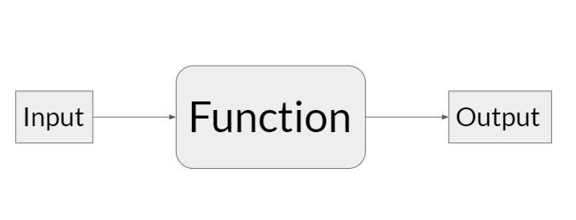
General Python Syntax
Getting Started
Comments allow sections of the code to be more readable
Anything after a “#” is a comment
# I am a comment!
Functions take in inputs and give outputs
print(input)
The print function prints out the input
print("hello world")
Notes:
We’re going to first talk about some general python syntax that will be helpful for any piece of code you write: Commenting and Functions
Comments are technically optional but they are useful to make your code readable to both yourself and others. In order to make a comment, just type a # symbol followed by the contents of the comment. You will know when something is commented because it will turn green. I generally use comments to…
Functions will be discussed more in depth in the future, but for now, the most relevant information to remember about functions is how to use a function, or calling a function. First, you put the name of the function followed by open parentheses and then any inputs followed by closed parentheses. I’m going to introduce the print function. This function will take whatever input you give and print it to the screen.
Let’s switch over to the colab screen. (demo hello world with a comment).

Slide 25
Lecture Outline
Google Colab
General Python Syntax
Variables
Logic
Control Flows

Slide 26
Variables
Overview
A variable is a reserved place in memory (think: container) which can store a value
Creating variables: variable_name = value
Can be used anywhere after its assignment, but never before
Can re-assign values as needed
7 types of values: Integer, Floating-point, String, Boolean, List, Tuple, and Dictionary
(More details about each type coming up in next slides)
var_a = 25
var_a = 70
print(var_a)
Notes:
Let’s get a quick high-level overview of variables before going into more detail. First off, what are variables? Variables are used to store data. They are like containers that hold a certain value: we’ll go over the different types of values later on because there’s a lot of them.
In Python, in order to create a variable, you type in the name of the variable, followed by an equals sign, and then followed by the desired value of the variable. This value will then be stored in the variable. This variable will be remembered for the entire program, and you can access or change it at any time in the future.
Alright, lets switch over to colab again and test out some variables. Also mention that typing in the variable will print it.

Slide 27
Variables
Names
"3rd_variable"
Cannot start with a number
Cannot include spaces
Cannot be a keyword: https://www.w3schools.com/python/python_ref_keywords.asp
Should be descriptive
*Good practice: all lowercase with underscores for spacing
Good examples: datapoint_number, petal_width, ...
"my variable"
Notes:
Let’s go over some rules involving variable names. There are a couple hard rules that must be followed otherwise your program will break. There are also some soft rules that are just good practice.
These first three are hard rules so you must follow them.
The first rule is that variables cannot start with a number. This is to prevent the computer from confusing a variable with a number.
The second rule is that variables cannot have spaces. Use underscores instead.
The third rule is variable names cannot be the same as a keyword that’s already used by Python and is reserved for other purposes.
Additionally, these last two are soft rules that are good practice.
Variable names should be descriptive. You will likely be using the same variables over and over again, so giving them a good name makes it easy to remember what their purpose is.
Next up, variables should follow the snake case convention. This means they should be composed of all lower case letters with underscores for spacing.

Slide 28
Variables
Self-test
70 ⇒ because the value of variable_b is set to be 70 in the second line
40 ⇒ because the value of variable_b is set to be the same as variable_a which is 40
25 ⇒ because the value of variable_b is set to be the same as variable_a which is 25
What does the following code output?
variable_a = 25
varaible_b = 70
variable_a = 40
variable_b = variable_a
print(variable_b)

Slide 29
Variables
Self-test
70 ⇒ because the value of variable_b is set to be 70 in the second line
40 ⇒ because the value of variable_b is set to be the same as variable_a which is 40
25 ⇒ because the value of variable_b is set to be the same as variable_a which is 25
What does the following code output?
variable_a = 25
varaible_b = 70
variable_a = 40
variable_b = variable_a
print(variable_b)

Slide 30
Variables
Integer
Non-fractional number
Positive or negative
No maximum or minimum practically
first_number = 1
second_number = 5
third_number = -3
Notes:
One type of data you can store within a variable is an integer.
An integer is a…

Slide 31
Variables
Floating-point
“Float”
Decimal point number
Accurate within 2⁻⁵⁵
petal_length = 3.5
petal_width = 4.0
pi = 3.14159265358
3.1415926
Floating (Decimal) Point
Notes:
Another type of number is a floating point number, more commonly known as a decimal point number.
Floating point numbers can have very long decimals, and will be accurate within… which for most purposes is perfectly accurate.

Slide 32
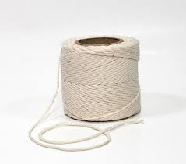
Variables
String
Not this
A string of characters
Put in quotations " " or ' '
*Block string (multi-line string): three quotation marks
*Special character (new line): "\n"
first_string = "s"
second_string = "string 2"
second_string = "another string"
Notes:
Ask audience for string recommendations
Replace the variable names to relate to IRIS
Generally, whatever you gives to a computer, it is taken as a string.
We will use this a lot when we deal with data.

Slide 33
Variables
Boolean
True or False (capitalize)
first_boolean = True
second_boolean = False
Notes:
When we talk about controls, we will be using Boolean

Slide 34
Variables
List
[a, b, c, d, e]
0 1 2 3 4
A list of values
my_list = [value_1, value_2, ...]
example_list = [5, 20, 11, 3, 10]
Can include multiple different data types
multi_type_list = ["hello world", True, 5]
For a specific value in the list: my_list[index]
The index of the 1st item is 0,
a_value = my_second_list[2] # gets the THIRD value in the list
There is also negative indexing (index of -1 gets last element, -2 gets second from last, etc.)
Notes:
A list is very commonly used in python, a list contains a series of values, even other lists. Lists are created when you surround multiple values separated by commas within square brackets. All these elements can be accessed individually using a square bracket operator. In programming, counting often starts at 0. So, in order to get the first element in an array, you need to put the number 0 within the square brackets.
Mention pointer/index intuition?
Just a fun fact: do you know why index starts with 0 instead of 1?

Slide 35
Variables
Self-test
22 ⇒ because value is set to the second item in the list
23 ⇒ because value is set to the third item in the list
What does the following code output?
my_list = [21, 22, 23, 24, 25]
value = my_list[2]
print(value)

Slide 36
Variables
Self-test
22 ⇒ because value is set to the second item in the list
23 ⇒ because value is set to the third item in the list
What does the following code output?
my_list = [21, 22, 23, 24, 25]
value = my_list[2]
print(value)

Slide 37
Variables
* Tuple
Works the same as a list, but can’t be changed
Can contain multiple different data types
my_first_tuple = (object_1, object_2, ...)
my_second_tuple = (22, "hello!", True, 3.1415)
a_value = my_second_tuple[2] # gets the THIRD value in the tuple
Notes:
We will not cover Tuple and Disctionary here. The slides are here for your information.
Like a list, a tuple is used to hold many variables. A tuple is created when you surround comma separated values within parentheses, in contrast to a list which uses square brackets. Furthermore, the values in a tuples cannot be changed (immutable).

Slide 38
Variables
* Dictionary
A list of values with custom keys that are indices, like a list but indices are keys and not positions
my_dictionary={'apple':'fruit', 'banana':'fruit', 'cabbage':'vegetable', 'dragonfruit':'fruit','eggplant':'vegetable'}
print(my_dictionary['cabbage'])
Notes:
Think of it like a phonebook.
Instead of storing values at a certain numerical index, you can also store elements using other values as indexes, such as strings. In this example, the print statement prints the value with a string “cabbage” as its key. Looking at the previous line, the value with a key of “cabbage” is the string “vegetable”. Notice how you still use the square brackets to access individual elements similarly to lists and typles.
17: [possible?] hashtable explanation? Also, mention that “you will notice that getting objects in the dictionary has the same semantics as list access, both are called "indexing"”

Slide 39
Variables
Type Conversion
Types: int, float, str, bool, list, tuple
Convert types of variables to other types
my_float = float(my_string) #gives string in float form if possible
Compatible types:
int → float
float → int (always rounds down)
str → int
str → float
*[most types] → string
*list → tuple
*boolean → int/float (0 → False, anything else → True)
*str → list/tuple (only converts str to list/tuple of single characters)
Notes:
Explain why we need to do type conversion
Do a colab example switch string to float in Iris dataset.
“Truthy”, “falsy”
Simplify a bit this slide

Slide 40
Variables
Basic Arithmetic Operations
+ | - | * | ** | / | // | %
Addition | Subtraction | Multiplication | Exponentiation | Division (turns int to float) | Floor Division (rounds down the quotient) | Modulus (returns the remainder)
x + y 1 + 2 == 3 | x - y 2 – 1 == 1 | x * y 2 * 3 == 6 | x ** y 2 ** 3 == 8 | x / y 8 / 2 == 4.0 | x // y 9 // 4 == 2 | x % y 10 % 4 == 2
Note: the double equal sign a == b is used to check for equality instead of assigning variables

Slide 41
Variables
Basic Arithmetic Operations
Changing a variable’s value:
x = 4
x = x + 1
# x becomes 5
x = 4
x = x - 2
# x becomes 2
x = 4
x = x * 2
# x becomes 8

Slide 42
Lecture Outline
Google Colab
General Python Syntax
Variables
Logic
Control Flows

Slide 43
Logic
Conditionals
if statement_1:
Code segment 1
elif statement_2: # elif means else if
Code segment 2
else:
Code segment 3
Notes:
Explain it as pseudo-english

Slide 44
Logic
Conditionals
x =
y =
if x == y:
print('x is equal to y')
elif x > y:
print('x is greater than y')
else:
print('x is less than y')
1
1
Notes:
Ask audience what they expect it to do

Slide 45
Logic
Conditionals
x = 4
y =
if x == y:
print('x is equal to y')
elif x > y:
print('x is greater than y')
else:
print('x is less than y')
1
Notes:
Ask audience what they expect it to do

Slide 46
Logic
Conditionals
x = 4
y =
if x == y:
print('x is equal to y')
elif x > y:
print('x is greater than y')
else:
print('x is less than y')
10
Notes:
Ask audience what they expect it to do

Slide 47
Logic
Conditionals
== != < > <= >=
== True if the two sides are exactly the same (1 == 1 is True)
!= True if the two sides are NOT the same (2 != 1 is True)
Notes:
Talk about how logic operators “replace” expression with a boolean, also maybe mention floating point issues
Also mention there aren’t compound inequalities

Slide 48
Logic
Conditionals
x = 4
y = 4
if x < y or x == y:
print("x is less than or equal to y")
and: only runs if both are True
if 1 == 1 and 1 == 2:
code segment…
or: runs if at least one of them are True
if 1 == 1 or 1 == 2:
code segment…
Notes:
Go through a bit faster

Slide 49
Logic
petal_width = 1.8
petal_length = 3.5
if petal_width < 3 or petal_length < 3:
print("condition 1 passed")
if petal_width < 3 and petal_length < 3:
print("condition 2 passed")
if petal_width < 3:
if petal_length < 3:
print("condition 3 passed")
Self-Test
Which of these conditions are successfully passed?

Slide 50
Logic
petal_width = 1.8
petal_length = 3.5
if petal_width < 3 or petal_length < 3:
print("condition 1 passed")
if petal_width < 3 and petal_length < 3:
print("condition 2 passed")
if petal_width < 3:
if petal_length < 3:
print("condition 3 passed")
Self-Test
Which of these conditions are successfully passed?

Slide 51
Lecture Outline
Google Colab
General Python Syntax
Variables
Logic
Control Flows

Slide 52
Control Flows
Hypothetical Scenario
We have this very large list of 11 words:
How do we access and print out every word?
word_list = ["Lorem", "ipsum", "dolor", "sit", "amet", "fusce", "rhoncus", "mi", "viverra", "velit", "mattis"]

Slide 53
Control Flows
Hypothetical Scenario
word_list = ["Lorem", "ipsum", "dolor", "sit", "amet", "fusce", "rhoncus", "mi", "viverra", "velit", "mattis"]
print(word_list[0])
print(word_list[1])
print(word_list[2])
print(word_list[3])
print(word_list[4])
print(word_list[5])
print(word_list[6])
print(word_list[7])
print(word_list[8])
print(word_list[9])
print(word_list[10])
Horribly inefficient
A lot of tedious manual coding
Completely unscalable (what if there were 70 words)

Slide 54
Control Flows
Hypothetical Scenario
print(word_list[0])
print(word_list[1])
print(word_list[2])
print(word_list[3])
print(word_list[4])
print(word_list[5])
print(word_list[6])
print(word_list[7])
print(word_list[8])
print(word_list[9])
print(word_list[10])
Only difference between all these lines is the index

Slide 55
Control Flows
For loops
How to use: for iterator in iterable:
String, list, range, etc. iterable
Need indentation
word_list = ["Lorem", "ipsum", "dolor", "sit", "amet", "fusce", "rhoncus", "mi", "viverra", "velit", "mattis"]
for number in range(0, 11): #range goes through 0, 1, 2, … 10
#this loop repeats 11 times and number changes to each number
print(word_list[number])
Notes:
Explain different types of iterables
Iterator, Iterable, Iteration

Slide 56
Control Flows
For loops
word_list = ["Lorem", "ipsum", "dolor", "sit", "amet", "fusce", "rhoncus", "mi", "viverra", "velit", "mattis"]
for number in range(0, 11): #range goes through 0, 1, 2, … 10
#this loop repeats 11 times and number changes to each number
print(word_list[number])
for word in word_list:
#this loop does the exact same thing but with less typing
print(word)
Notes:
Think about the for loop as going through a to-do list
Explain different types of iterables
Indentation tells which block of codes the for loop runs through
Make animation of box going through hello world array
Maybe just “hello” instead of “hello world”?

Slide 57
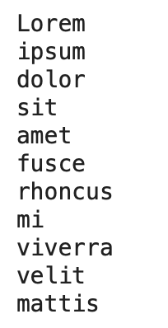
Control Flows
Self-test
Output:
word_list = ["Lorem", "ipsum", "dolor", "sit", "amet", "fusce", "rhoncus", "mi", "viverra", "velit", "mattis"]
for word in word_list:
#this loop does the exact same thing but with less typing
print(word)
Notes:
Think about the for loop as going through a to-do list
Explain different types of iterables
Indentation tells which block of codes the for loop runs through
Make animation of box going through hello world array
Maybe just “hello” instead of “hello world”?

Slide 58
Control Flows
Self-test
big_list = ["Lorem", "Ipsum", "Dolor", "Sit", "Amet", "Consectetur", "Adipiscing", "Elit", "Sed"]
Which of the following code blocks will print out everything in the list?
a.
for word in big_list:
print(word)
b.
for i in range(9):
print(big_list[i])
c.
for word in big_list:
print(big_list[word])

Slide 59
Control Flows
Self-test
big_list = ["Lorem", "Ipsum", "Dolor", "Sit", "Amet", "Consectetur", "Adipiscing", "Elit", "Sed"]
Which of the following code blocks will print out everything in the list?
a.
for word in big_list:
print(word)
b.
for i in range(9):
print(big_list[i])
c.
for word in big_list:
print(big_list[word])

Slide 60
Control Flows
While
How to use: while statement:
The loop repeats as statement is true
Needs indentation
my_number = 0
while my_number < 6:
print(my_number)
my_number = my_number + 1
Notes:
A while loop is the other form of control flow. Similarly to a for loop, the while loop repeats as long as the statement is true
Be careful or it will run forever
Coding experiment: swap the two lines in the while loop
Coding experiment: do not indent the second line in the while loop

Slide 61
Control Flows
Don’t worry about what this code does.
Indentation
a_list = [3, 22, 1, 73, 40, 3, 19]
sum = 0
for i in range(0, 7):
sum = sum + a_list[i]
sum = sum / 2.4
sum = sum * -1
print(a_list[i])
print(sum)
Inside loop because of indentation
(tab)

